Slide 1

Presentation on:
OUR SHORT JOURNEY AT
BRAC BANK LTD.
Small Credit, CRM
Supervisor: Md. Shamsuzzaman Shams
Unit Head-Credit and Portfolio Analysis

Slide 2
Ferdousi Jamal Uddin
North South University
Computer Science and Engineering
Major : Artificial Intelligence
Coding: Python, HTML, CSS
Hobby : Reading Books, Watching Movies, Dancing
Fahmida Islam
East West University
Information and Communication Engineering
Major : Machine Learning and Data Science
Coding : Python, R, HTML, CSS
Hobby : Travelling, Gardening, Baking
Jannatul Umma Asia
East West University
Information and Communication Engineering
Major : Machine Learning and Data Science
Coding : Python, R, Web development (HTML,CSS, JS)
Hobby : Gardening, Travelling, Art
Md. Nahinul Abdein Nahin
American International University, Bangladesh
Computer Science and Engineering
Major : Software Engineering
Coding: PHP(Laravel), Java, Python, Web development
Hobby : Football, Watching Anime, Cooking

Slide 3

What We Learned So Far:
Classification of Loan
Database
Dedupe Search
Sanction Search
Negative Search
LOS
Taking Updates
CIB Report
PPG
Monthly Bill

Slide 4

Classification of LOAN

Slide 5

Database

Slide 6
PPG
Nature & Legal Form of Business
Age of Business & Owner
Business Location
Owners Experience
Facility Type ( EMI, SIL, Structured Payment)
Loan Limit
Loan Tenor
Environment Policy

Slide 7
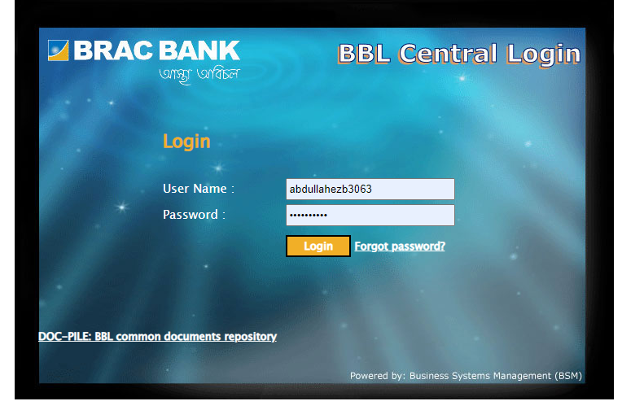
Dedupe Search

Slide 8
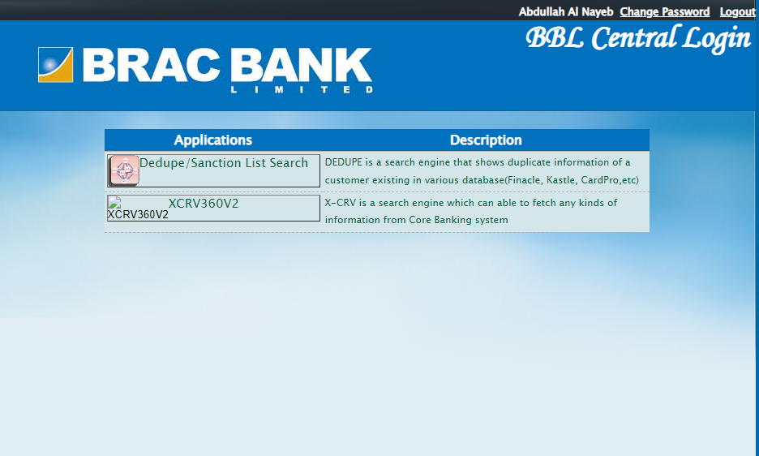
Dedupe Search

Slide 9
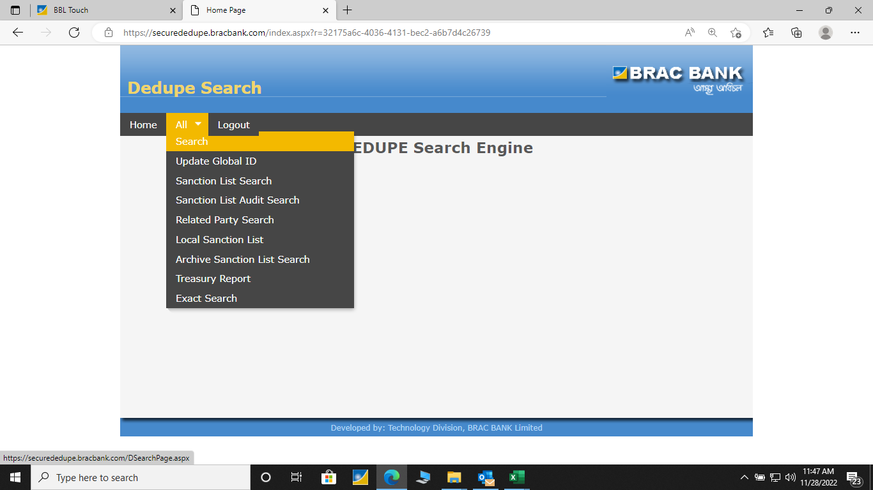
Dedupe Search

Slide 10
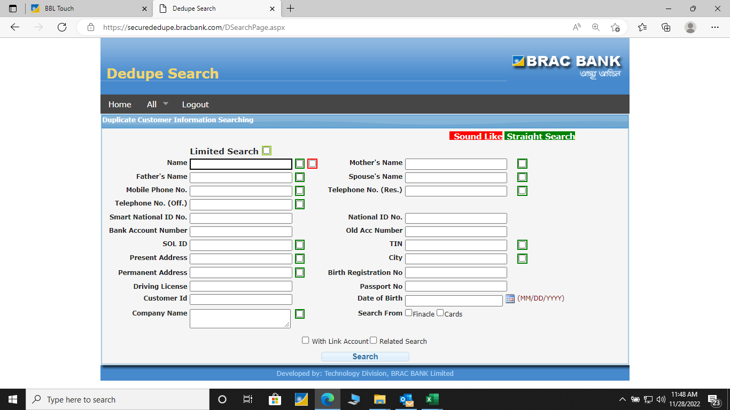
Dedupe Search

Slide 11
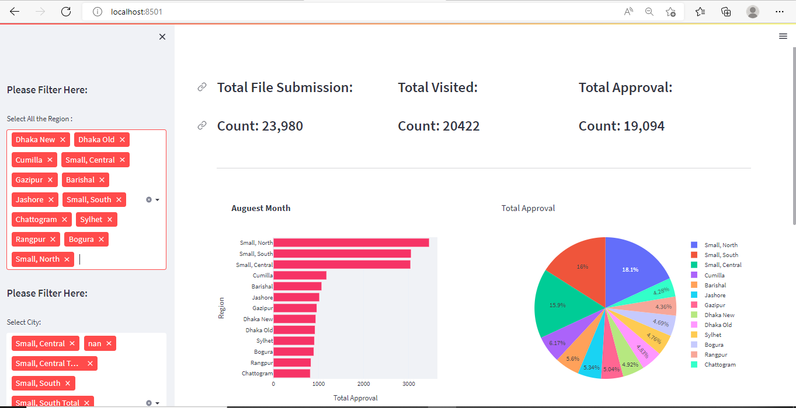
Streamlit Web application

Slide 12
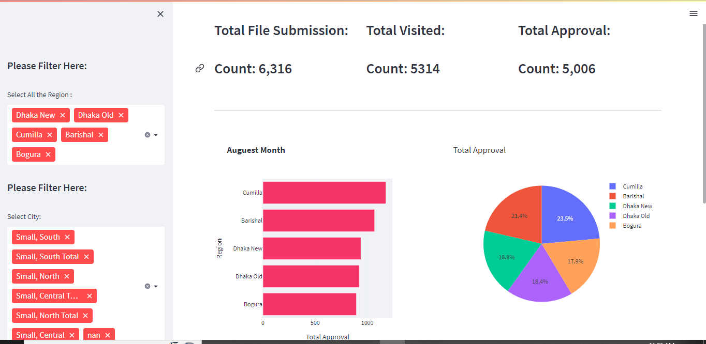
After filtering Region

Slide 13
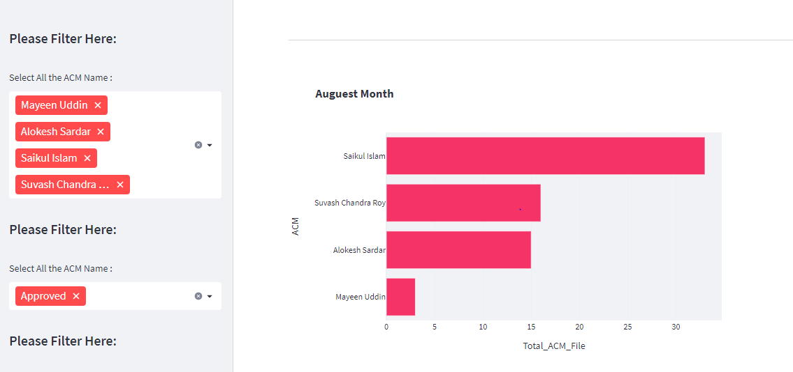
Prototype

Slide 14
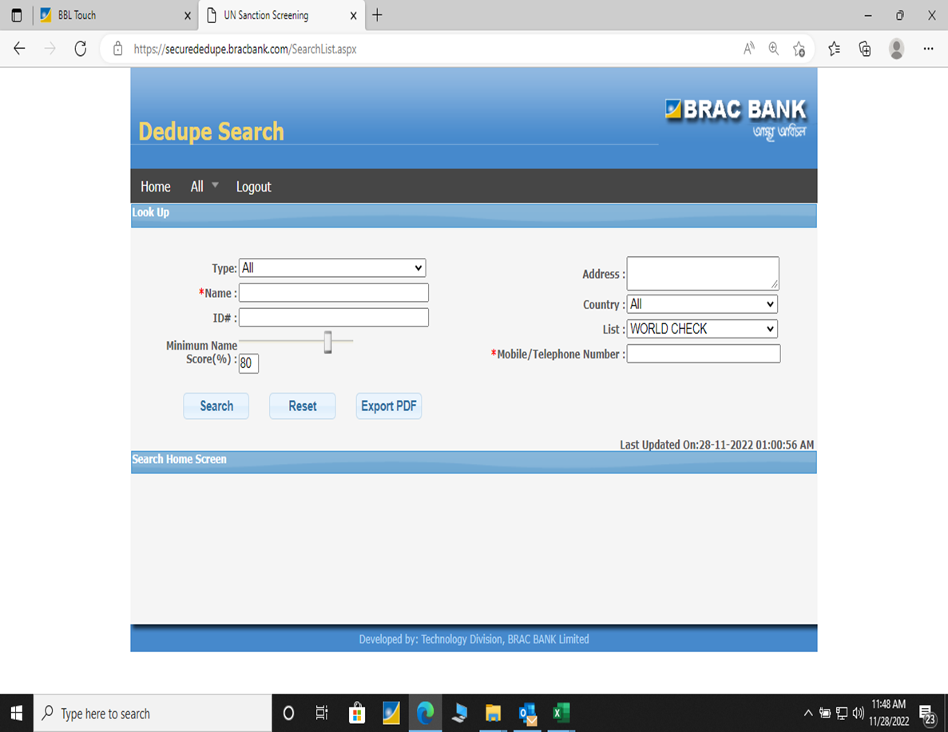
Sanction Search

Slide 15
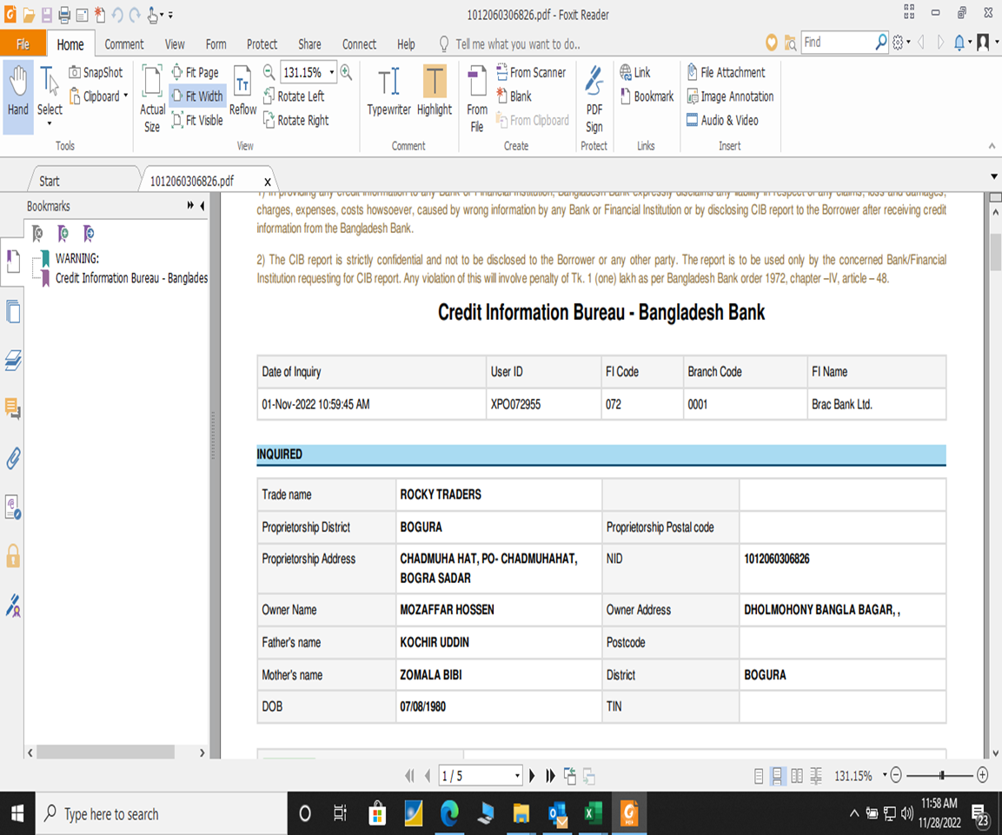
CIB Report

Slide 16
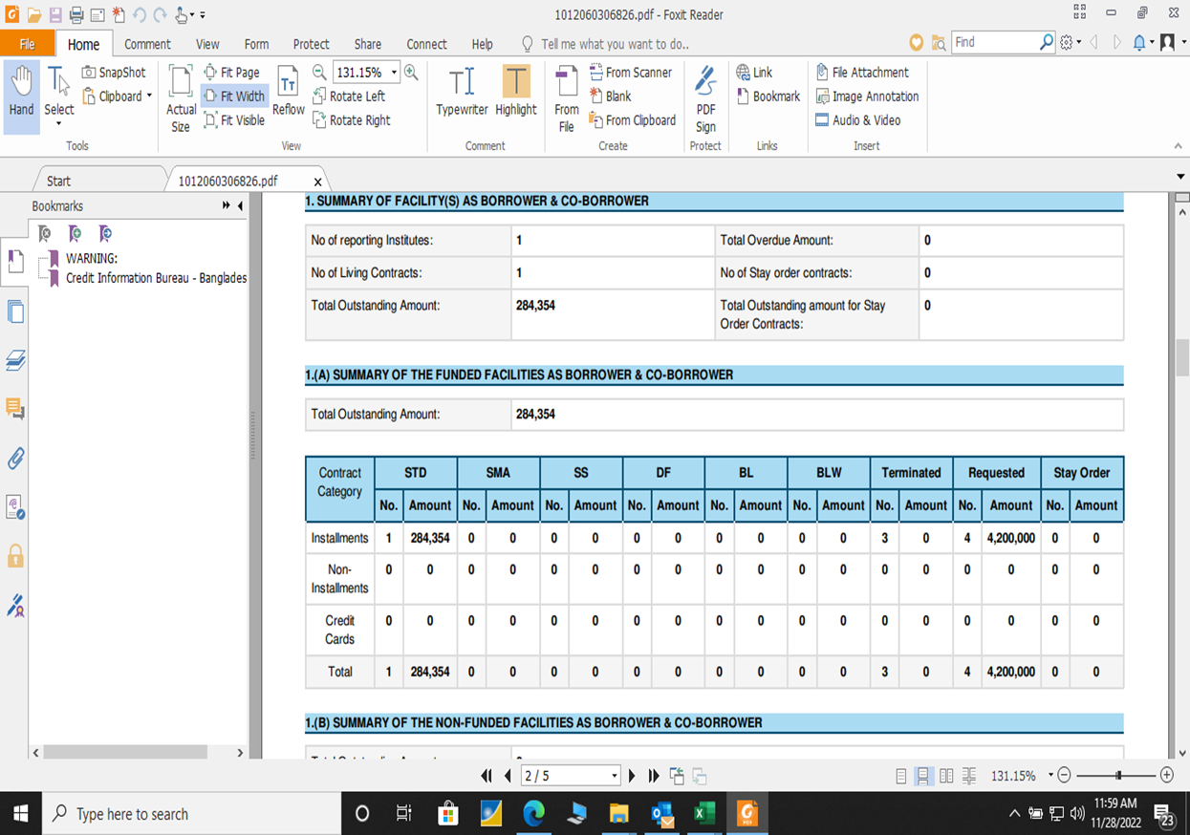
CIB Report

Slide 17
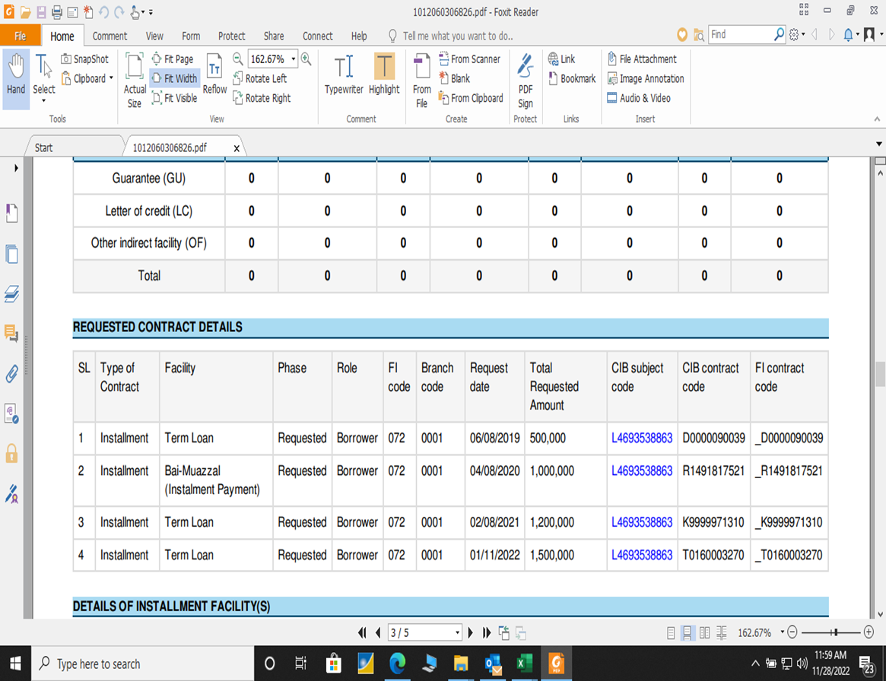
CIB Report

Slide 18
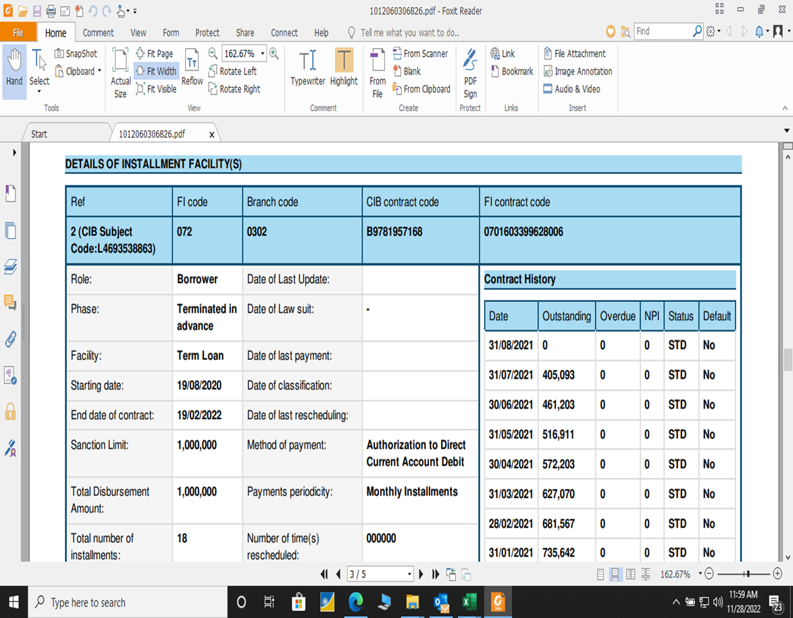
CIB Report

Slide 19
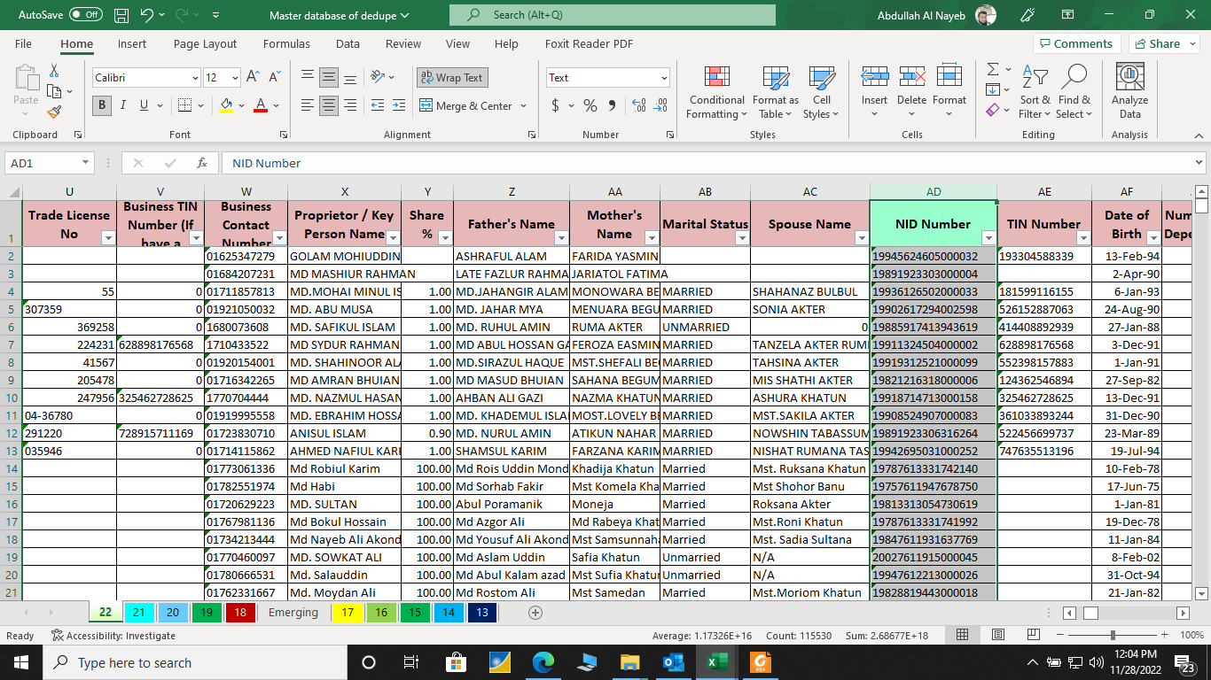
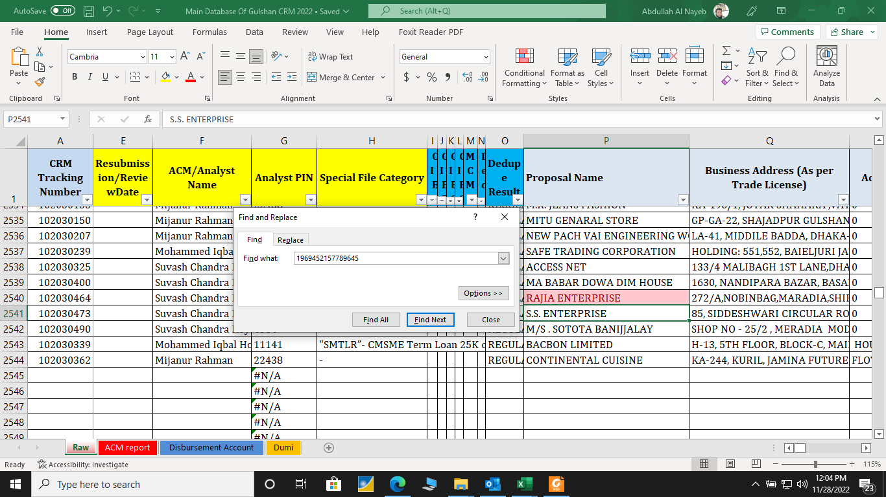
Negative Search

Slide 20
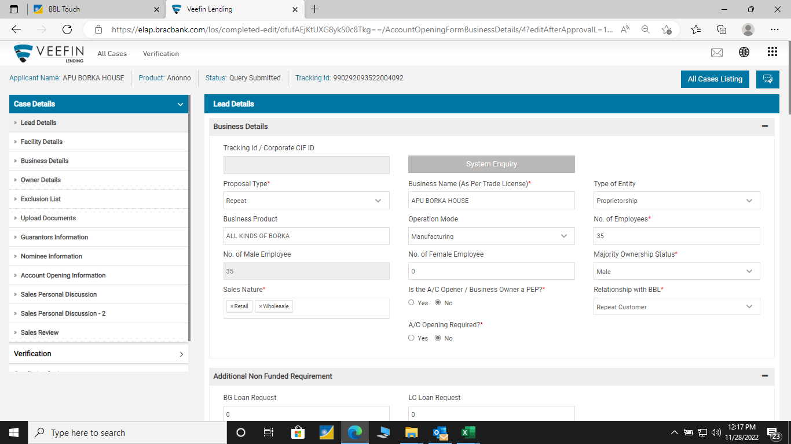
LOS(Loan Origination System)

Slide 21
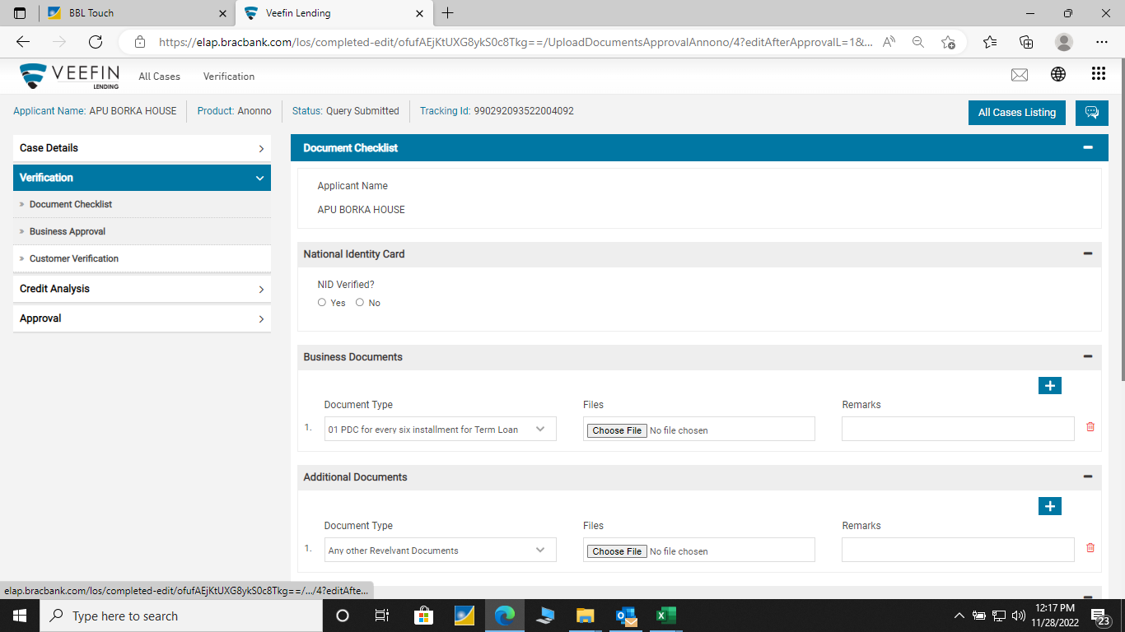
LOS(Loan Origination System)

Slide 22
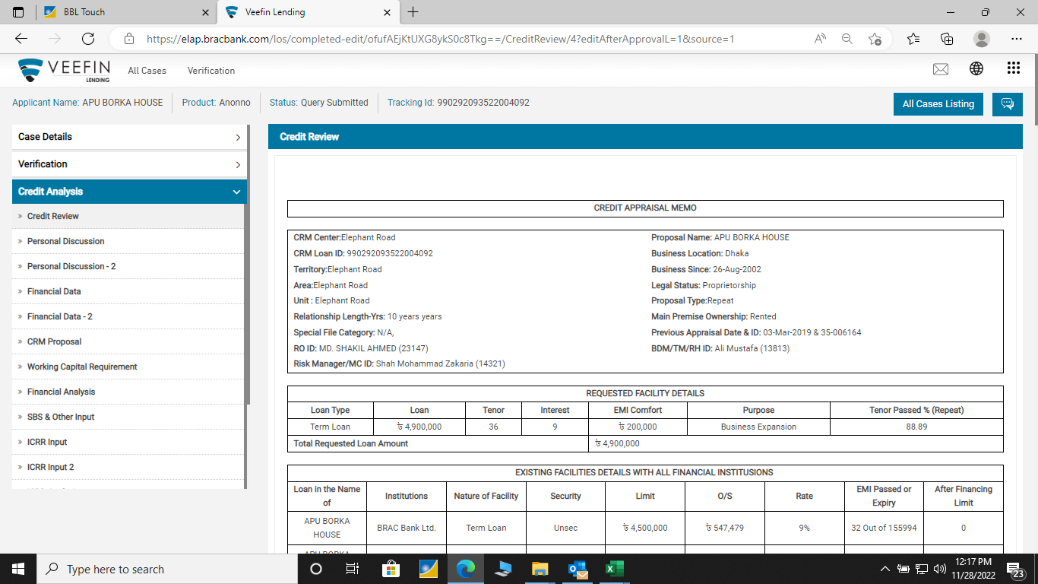
LOS(Loan Origination System)

Slide 23
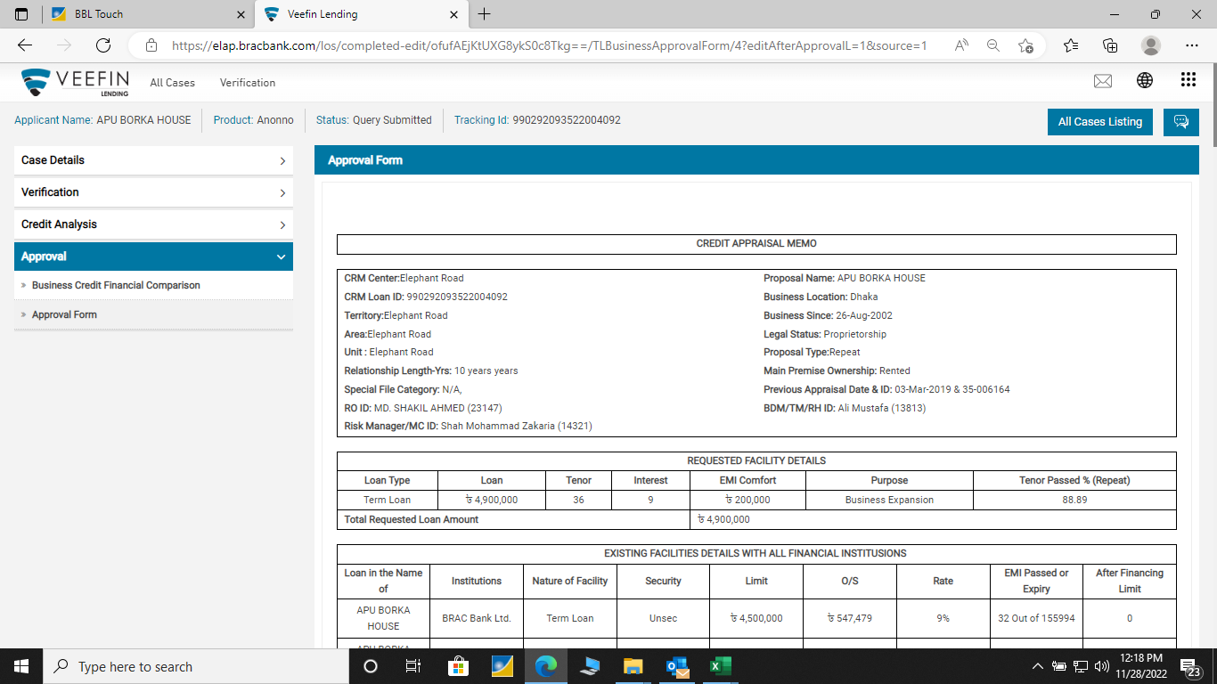
LOS(Loan Origination System)

Slide 24
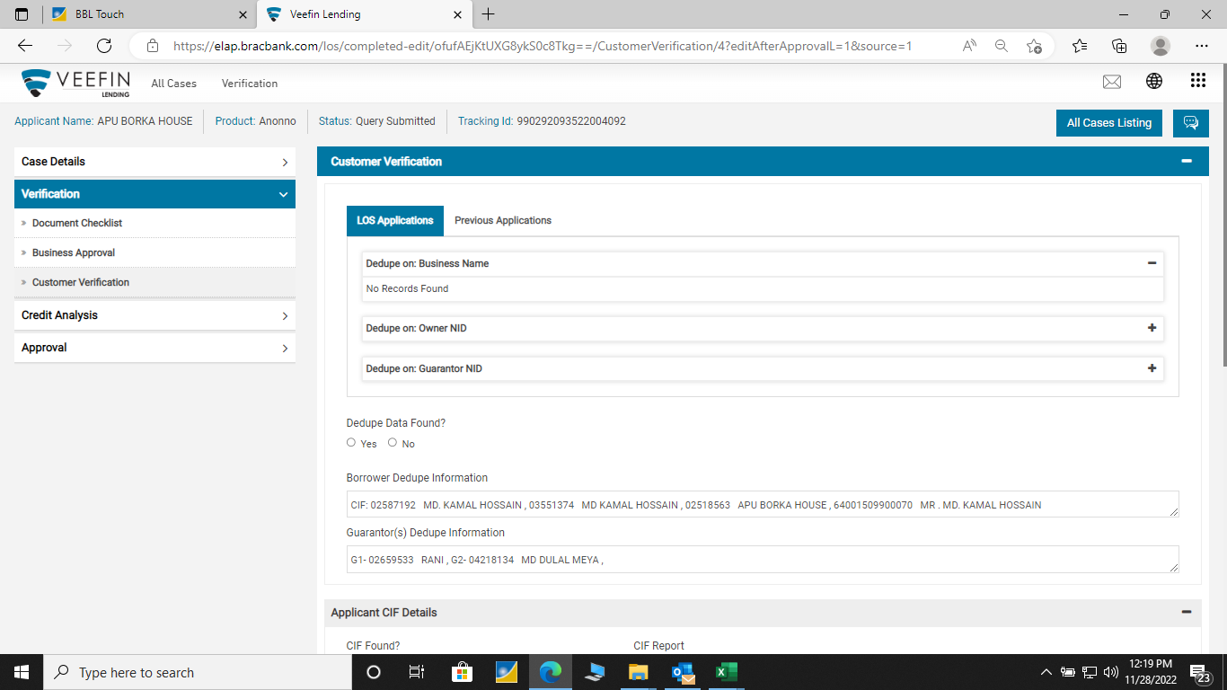
LOS(Loan Origination System)

Slide 25
LOS(Loan Origination System)
Business
RO
BDM
RM
TRADE
NID
NXAR
TIN
ENTRY
MIS
CIB
Dedupe
CIF
Main Database

Slide 26
Taking Updates
Contact by Telephone or Email
Getting Updates
Updating Data to Database
Provide Daily Report to RCH and MCs

Slide 27

Monthly Bill
Our task was to cross-check the entire expenditures incurred by the RM, RO, and Senior Manager and to compute, verify, and match the overall cost calculations for billing purposes for their project trips into and out of Dhaka.

Slide 28


